Slide 1


Welcome to Diet and Nutrition Support System App

Slide 2

Presented by: Md. Abul Basar
ID: 2102036
CCE 310 :: Software Development Project-I
Patuakhali Science and Technology University
Date: July 19, 2025

Slide 3

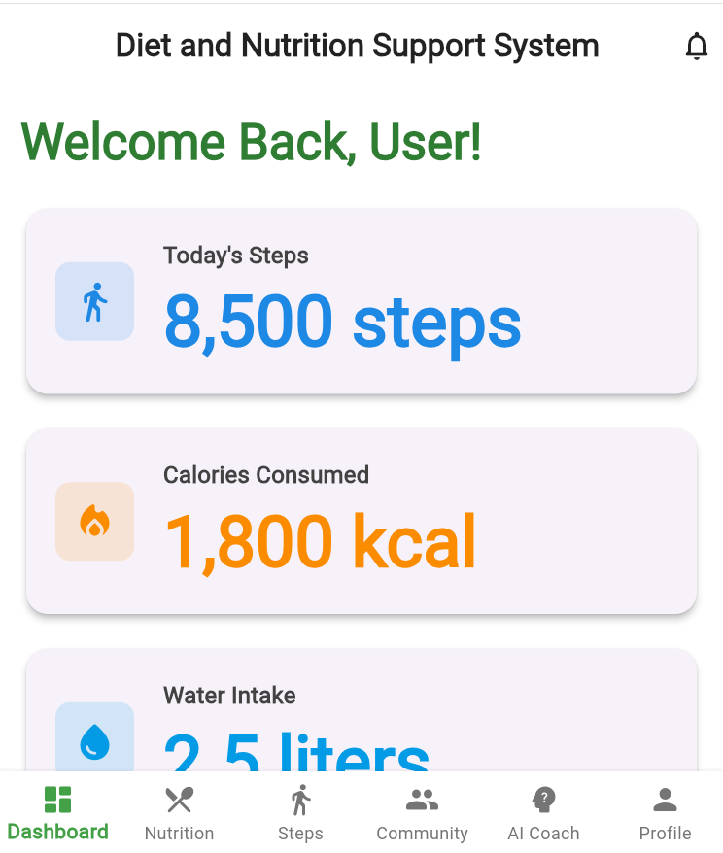
Introduction & Problem Heading: The Need for Diet and Nutrition Support System Content: Problem: 1. Limited diet and fitness apps with integrated step tracking and community support. 2. Existing apps often platform-specific or subscription-based.

Slide 4
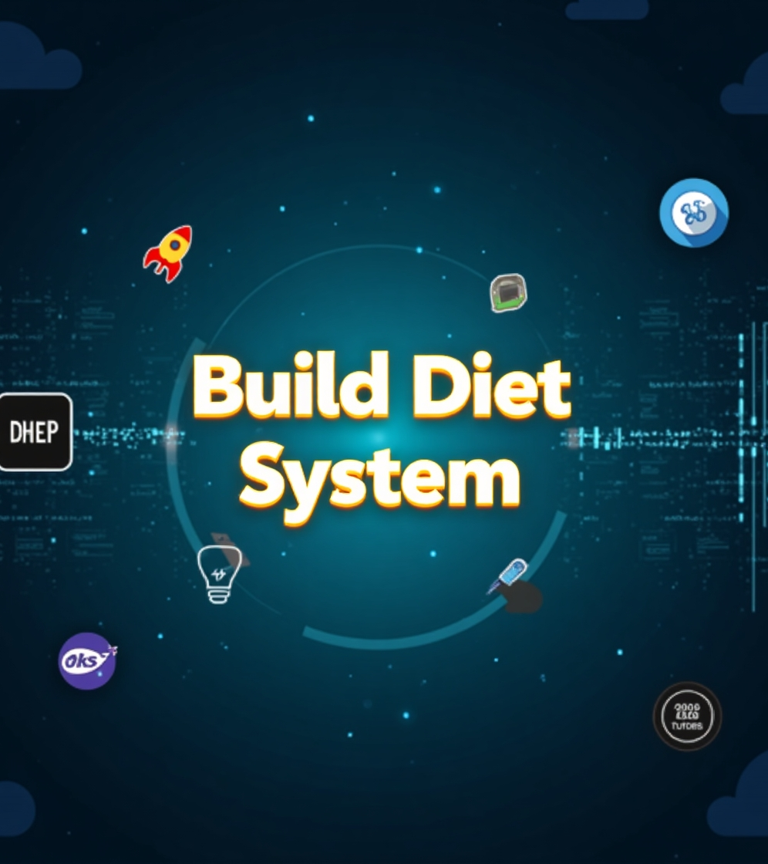

Objectives Heading: Our Goals Content: Build a cross-platform app with Flutter. Enable real-time step counting and diet logging. Offer personalized plans and community challenges.

Slide 5

Technology Stack Heading: Powering HealthySteps
Content:
Frontend: Flutter
Backend: Firebase
Database: Firestore
APIs: Google Fit
Tools: Figma, GitHub

Slide 6
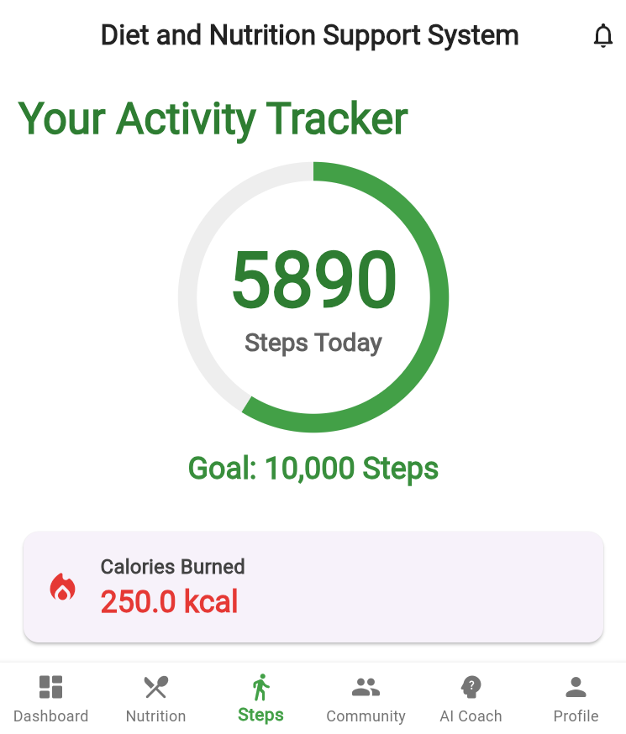
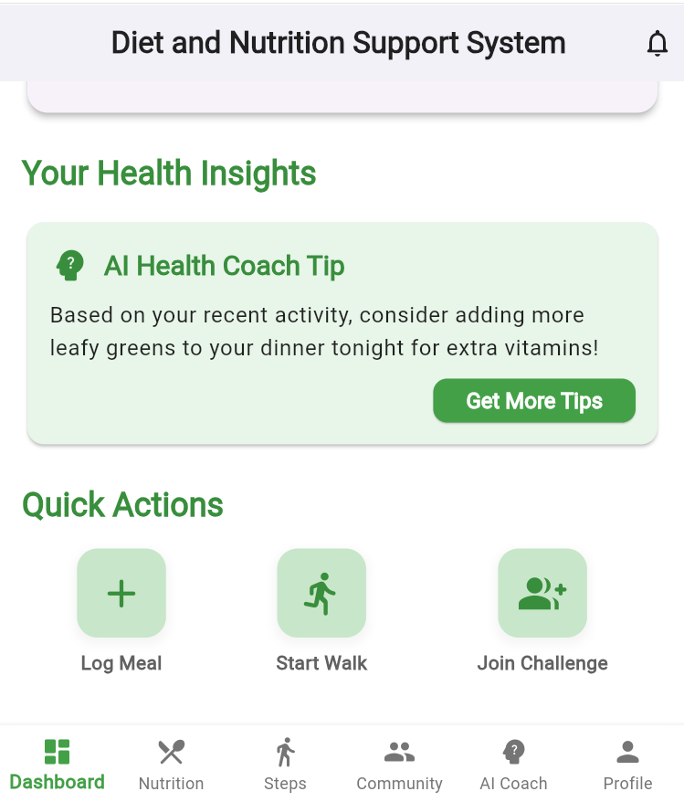
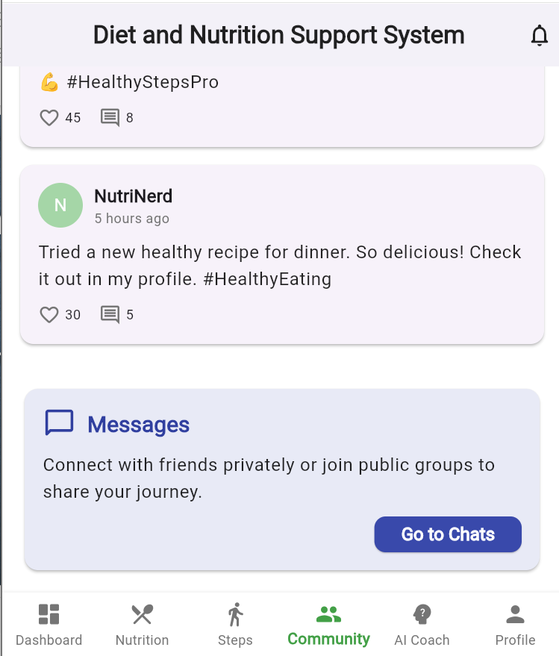
Key Features Heading: What Makes It Special
Content:
Step Counting with Motion Sensor
Personalized Diet Recommendations
Community Challenges

Slide 7
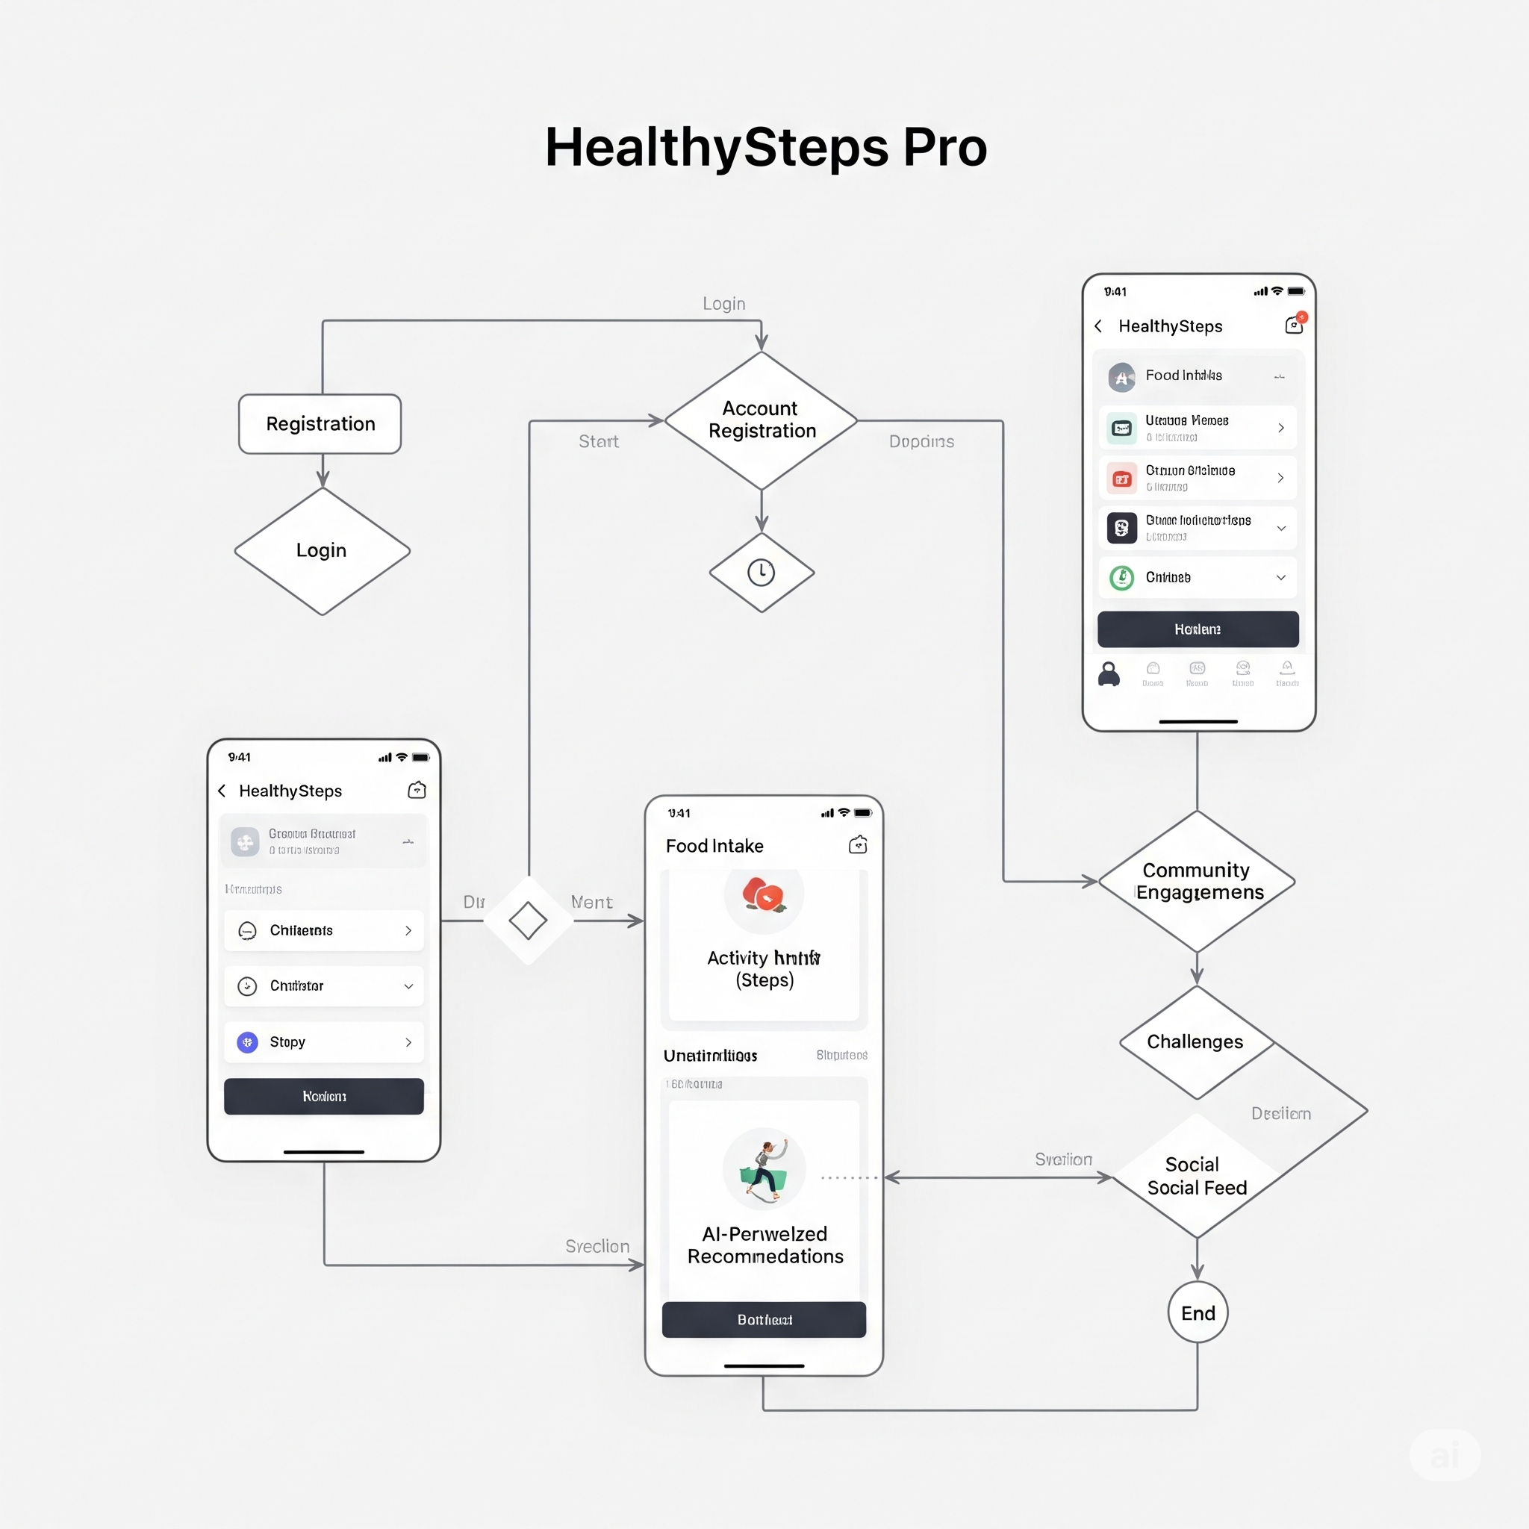
Visual Models – Flow Chart Diagram Heading: System Flow Chart
Content:
Text-based flow:
[User] → [Login/Signup] → [Dashboard]
→ [Step Tracking] → [Sync with Firestore]
→ [Diet Logging] → [AI Recommendations]
→ [Community] → [Challenges]

Slide 8
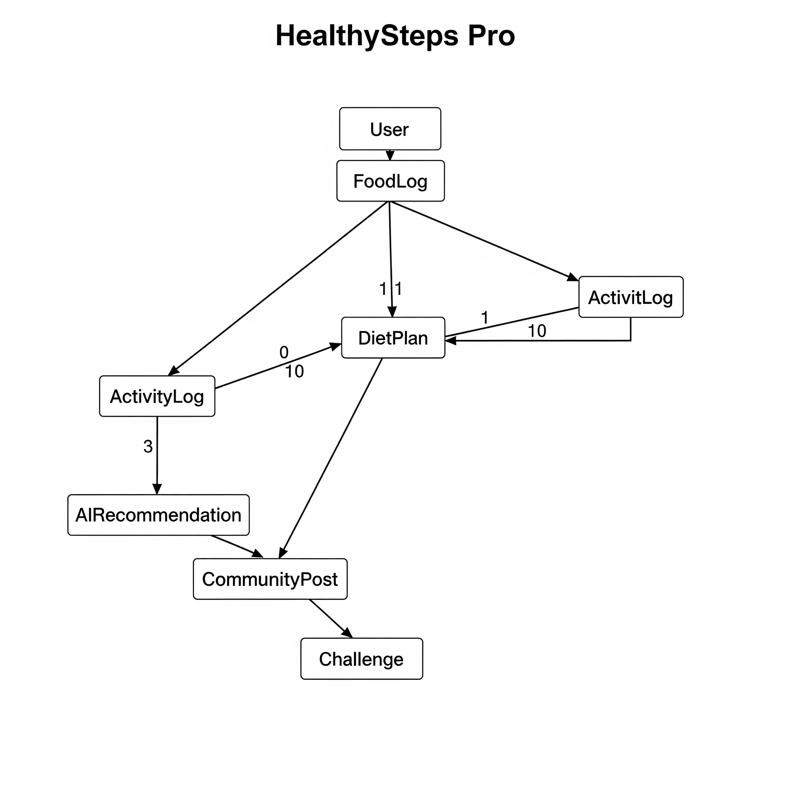
Visual Models - ER Diagram Heading: Entity Relationship Diagram
Content:
Text-based ERD:
User (user_id, email, password_hash, created_at)
StepData (step_id, user_id, steps_count, calories_burned, timestamp)
DietLog (log_id, user_id, food_item, calories, date)
Challenge (challenge_id, title, goal_steps, start_date, end_date, participants)

Slide 9
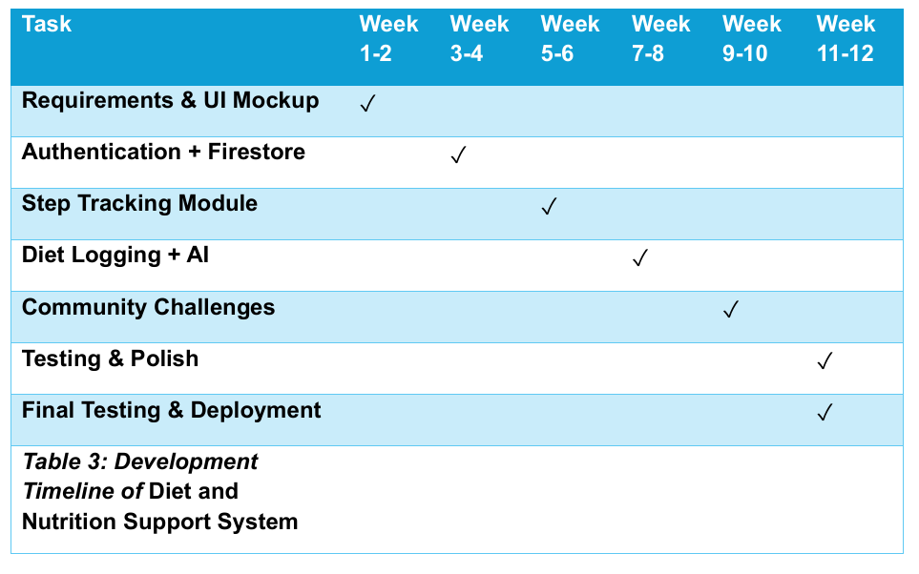
Timeline Heading: Project Timeline
Content:
Week 1-2: Requirements & Design
Week 3-8: Core Development
Week 9-12: Testing
Week 13-14: Demo & Report

Slide 10
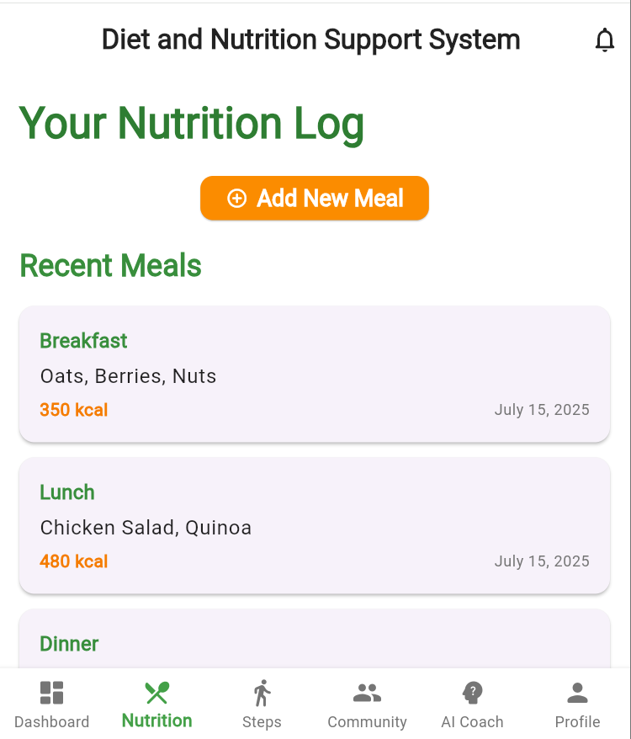
Expected Impact Making a Difference
Content:
Improved health awareness.
Engaged community support.
Scalable platform for future growth.

Slide 11
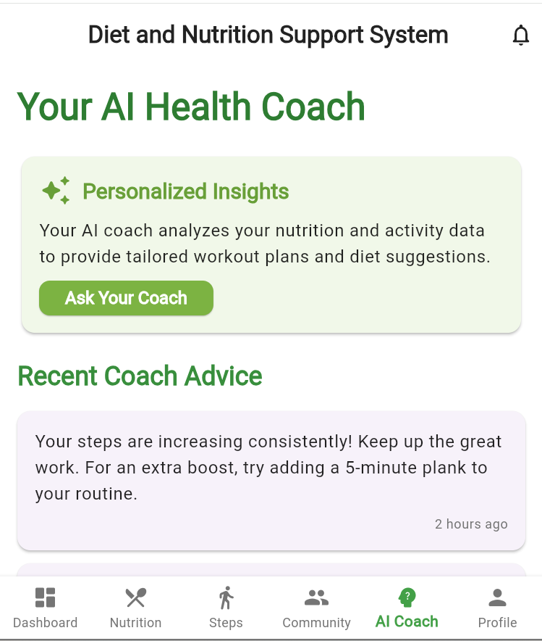
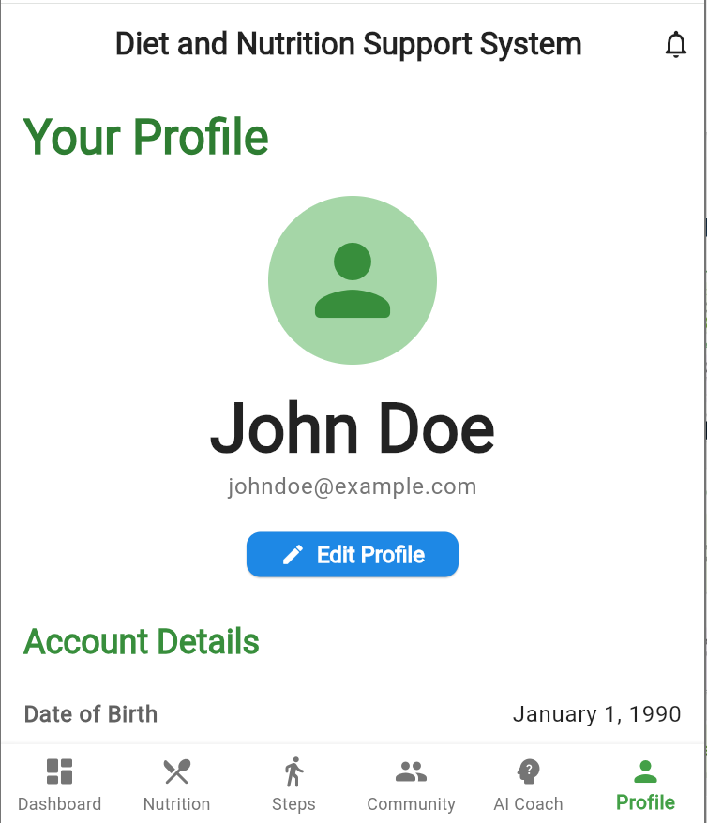
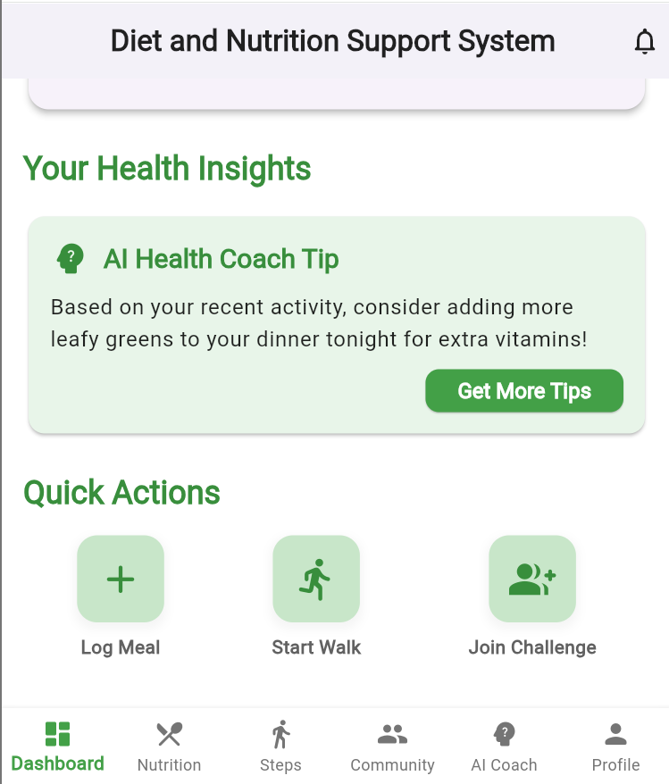
Mockup images

Slide 12
Thank you
Abul Basar
Contact: ug2102036@cse.pstu.ac.bd

